Slide 1

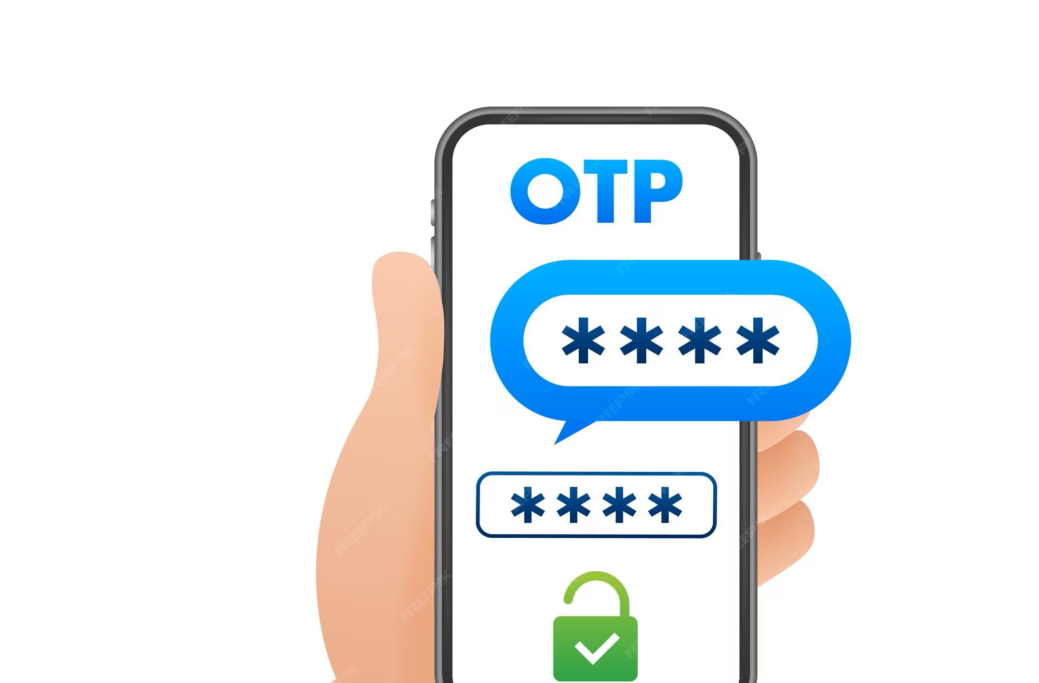
Capstone Project Python OTP Verification System BY: Payal Sahu

Slide 2
AGENDA
Problem Statement
Objectives
Tools & Technologies
System Components
Execution
Test Cases
Conclusion

Slide 3
Problem Statement
OTP Verification System – Project Highlights
1.Problem with Static Passwords Traditional passwords are static and often reused, making them vulnerable to breaches and phishing attacks.
Security Threats Weak passwords and repeated usage expose users to phishing, data breaches, and unauthorized access.
Need for Stronger Authentication Static credentials are insufficient for secure systems — a more dynamic method is essential.
OTP as a Solution One-Time Passwords offer a secure, time-limited, and session-specific verification method.
System Overview The Python-based system generates a secure 6-digit OTP and emails it to the user for identity verification.
User Verification Flow Users must input the received OTP; the system matches it to grant or deny access.
Authentication Benefits OTPs ensure user-specific, session-based verification, eliminating the risks of credential reuse.
Enhanced Security Outcome The OTP mechanism significantly reduces the risk of unauthorized access and strengthens data protection.

Slide 4
Objective
Our goal is to design a straightforward and reliable OTP (One-Time Password) verification system
Creates a random 6-digit OTP for secure validation
Mimics the process of emailing the OTP to the user
Checks the user’s input against the generated OTP
Manages potential errors without crashing the system
Offers the user another chance if the OTP is entered incorrectly

Slide 5
TOOLS and technologies
Google Collab (Jupyter Notebook)
Python
random module (OTP generation)
smtplib (Email simulation)
re (Pattern matching)
getpass (For securely handling password input)
time module (To handle delays, expiry, or retry limits)
Google SMTP Server (For sending OTPs via Gmail)
Exception Handling (To manage runtime errors gracefully)

Slide 6
System Components of OTP-Based Authentication
OTP Generator Module
Creates a random 6-digit code (OTP) for each login.
Makes sure a new and unique code is created every time.
Email Sending Module
Sends the OTP to the user’s email using Gmail.
Uses secure login details just for this purpose.
Handles errors if the email fails to send.
User Input Handler
Asks the user to enter the OTP they received.
Makes the input process simple and user-friendly.
OTP Checker
Compares the entered OTP with the one that was sent.
Decides if the login should succeed or fail.
Verification Flow Manager
Manages the full process: generate OTP → send email → get user input → check OTP.
Allows up to 3 tries if the user enters the wrong OTP.
Gives instant messages like “Success” or “Incorrect OTP” during the process.

Slide 7
EXECUTION
Launch the notebook/script in your preferred IDE or Google Collab.
Verify all dependencies are available: Python 3.x, random, smtplib.
Run the file: OTP_Verification_System.ipynb.
Provide your email address when prompted (an OTP will be sent to this address).
Enter the received OTP to complete the verification process.

Slide 8

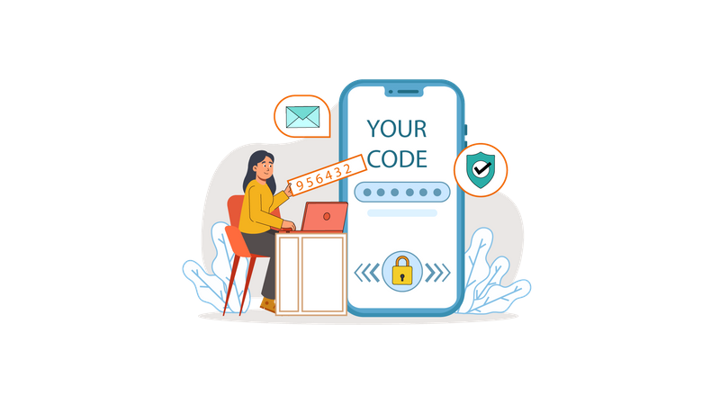
TEST CASES
Incorrect OTP Followed by Correct OTP
Scenario: User enters a wrong OTP initially but enters the correct one on the second or third attempt.
Expected Outcome: The system recognizes the valid OTP within the allowed attempts and grants access.
All OTP Attempts Failed
Scenario: User enters an incorrect OTP three times consecutively.
Expected Outcome: The system blocks access and terminates the verification process, displaying an "Access Denied" message.
Valid Email Entry
Scenario: User enters a correctly formatted and valid email address.
Expected Outcome: The system sends an OTP to the provided email and displays a prompt for OTP input.
Correct OTP on First Attempt
Scenario: User receives the OTP and enters it correctly on the first try.
Expected Outcome: The system validates the OTP and grants access immediately.

Slide 9
Conclusion
This project presents a simple yet effective OTP (One-Time Password) verification system.
It addresses security issues related to static passwords by using time-sensitive OTPs.
Demonstrates Python’s ability to:
Generate secure and random numeric codes
Send emails using SMTP protocol
Take and validate user input
Handle errors such as failed email delivery or wrong OTP entry
The system enhances login security by allowing only verified users.
It offers a hands-on example of building secure authentication using core Python libraries.
Highlights the real-world application of Python in cybersecurity and user authentication.

Slide 10


